Slide 1
Lecture Nine Squeeze Casting
Combination of casting and forging in which a molten metal is poured into a preheated lower die, and the upper die is closed to create the mold cavity after solidification begins
Differs from usual closed-mold casting processes in which die halves are closed before introduction of the molten metal
Compared to conventional forging, pressures are less and finer surface details can be achieved

Slide 2
Semi-Solid Metal Casting
Family of net-shape and near net-shape processes performed on metal alloys at temperatures between liquidus and solidus
Thus, the alloy is a mixture of solid and molten metals during casting (mushy state)
To flow properly, the mixture must consist of solid metal globules in a liquid
Achieved by stirring the mixture to prevent dendrite formation

Slide 3
Semi-Solid Metal Casting: Advantages
Complex part geometries
Thin part walls possible
Close tolerances
Zero or low porosity, resulting in high strength of the casting

Slide 4
Centrifugal Casting
A family of casting processes in which the mold is rotated at high speed so centrifugal force distributes molten metal to outer regions of die cavity
The group includes:
True centrifugal casting
Semicentrifugal casting
Centrifuge casting

Slide 5
True Centrifugal Casting
Molten metal is poured into rotating mold to produce a tubular part
In some operations, mold rotation commences after pouring rather than before
Parts: pipes, tubes, bushings, and rings
Outside shape of casting can be round, octagonal, hexagonal, etc , but inside shape is (theoretically) perfectly round, due to radially symmetric forces

Slide 6
True Centrifugal Casting
Setup for true centrifugal casting

Slide 7
Semicentrifugal Casting
Centrifugal force is used to produce solid castings rather than tubular parts
Molds use risers at center to supply feed metal
Density of metal in final casting is greater in outer sections than at center of rotation
Often used on parts in which center of casting is machined away, thus eliminating the portion where quality is lowest
Examples: wheels and pulleys

Slide 8
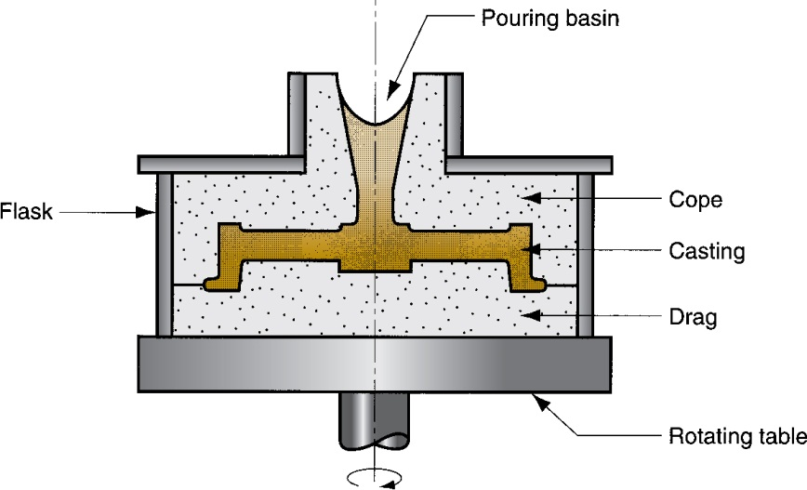
Semicentrifugal Casting

Slide 9
Centrifuge Casting
Mold is designed with part cavities located away from axis of rotation, so molten metal poured into mold is distributed to these cavities by centrifugal force
Used for smaller parts
Radial symmetry of part is not required as in other centrifugal casting methods

Slide 10
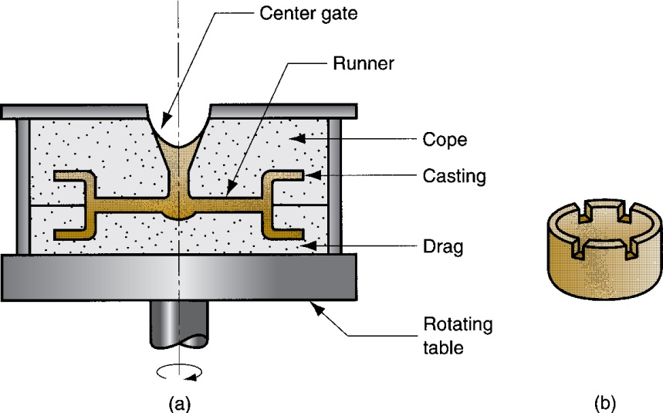
Centrifuge Casting
(a) The process and (b) one of the parts cast

Slide 11
Furnaces for Casting Processes
Furnaces most commonly used in foundries:
Cupolas
Direct fuel‑fired furnaces
Crucible furnaces
Electric‑arc furnaces
Induction furnaces

